Slide 1

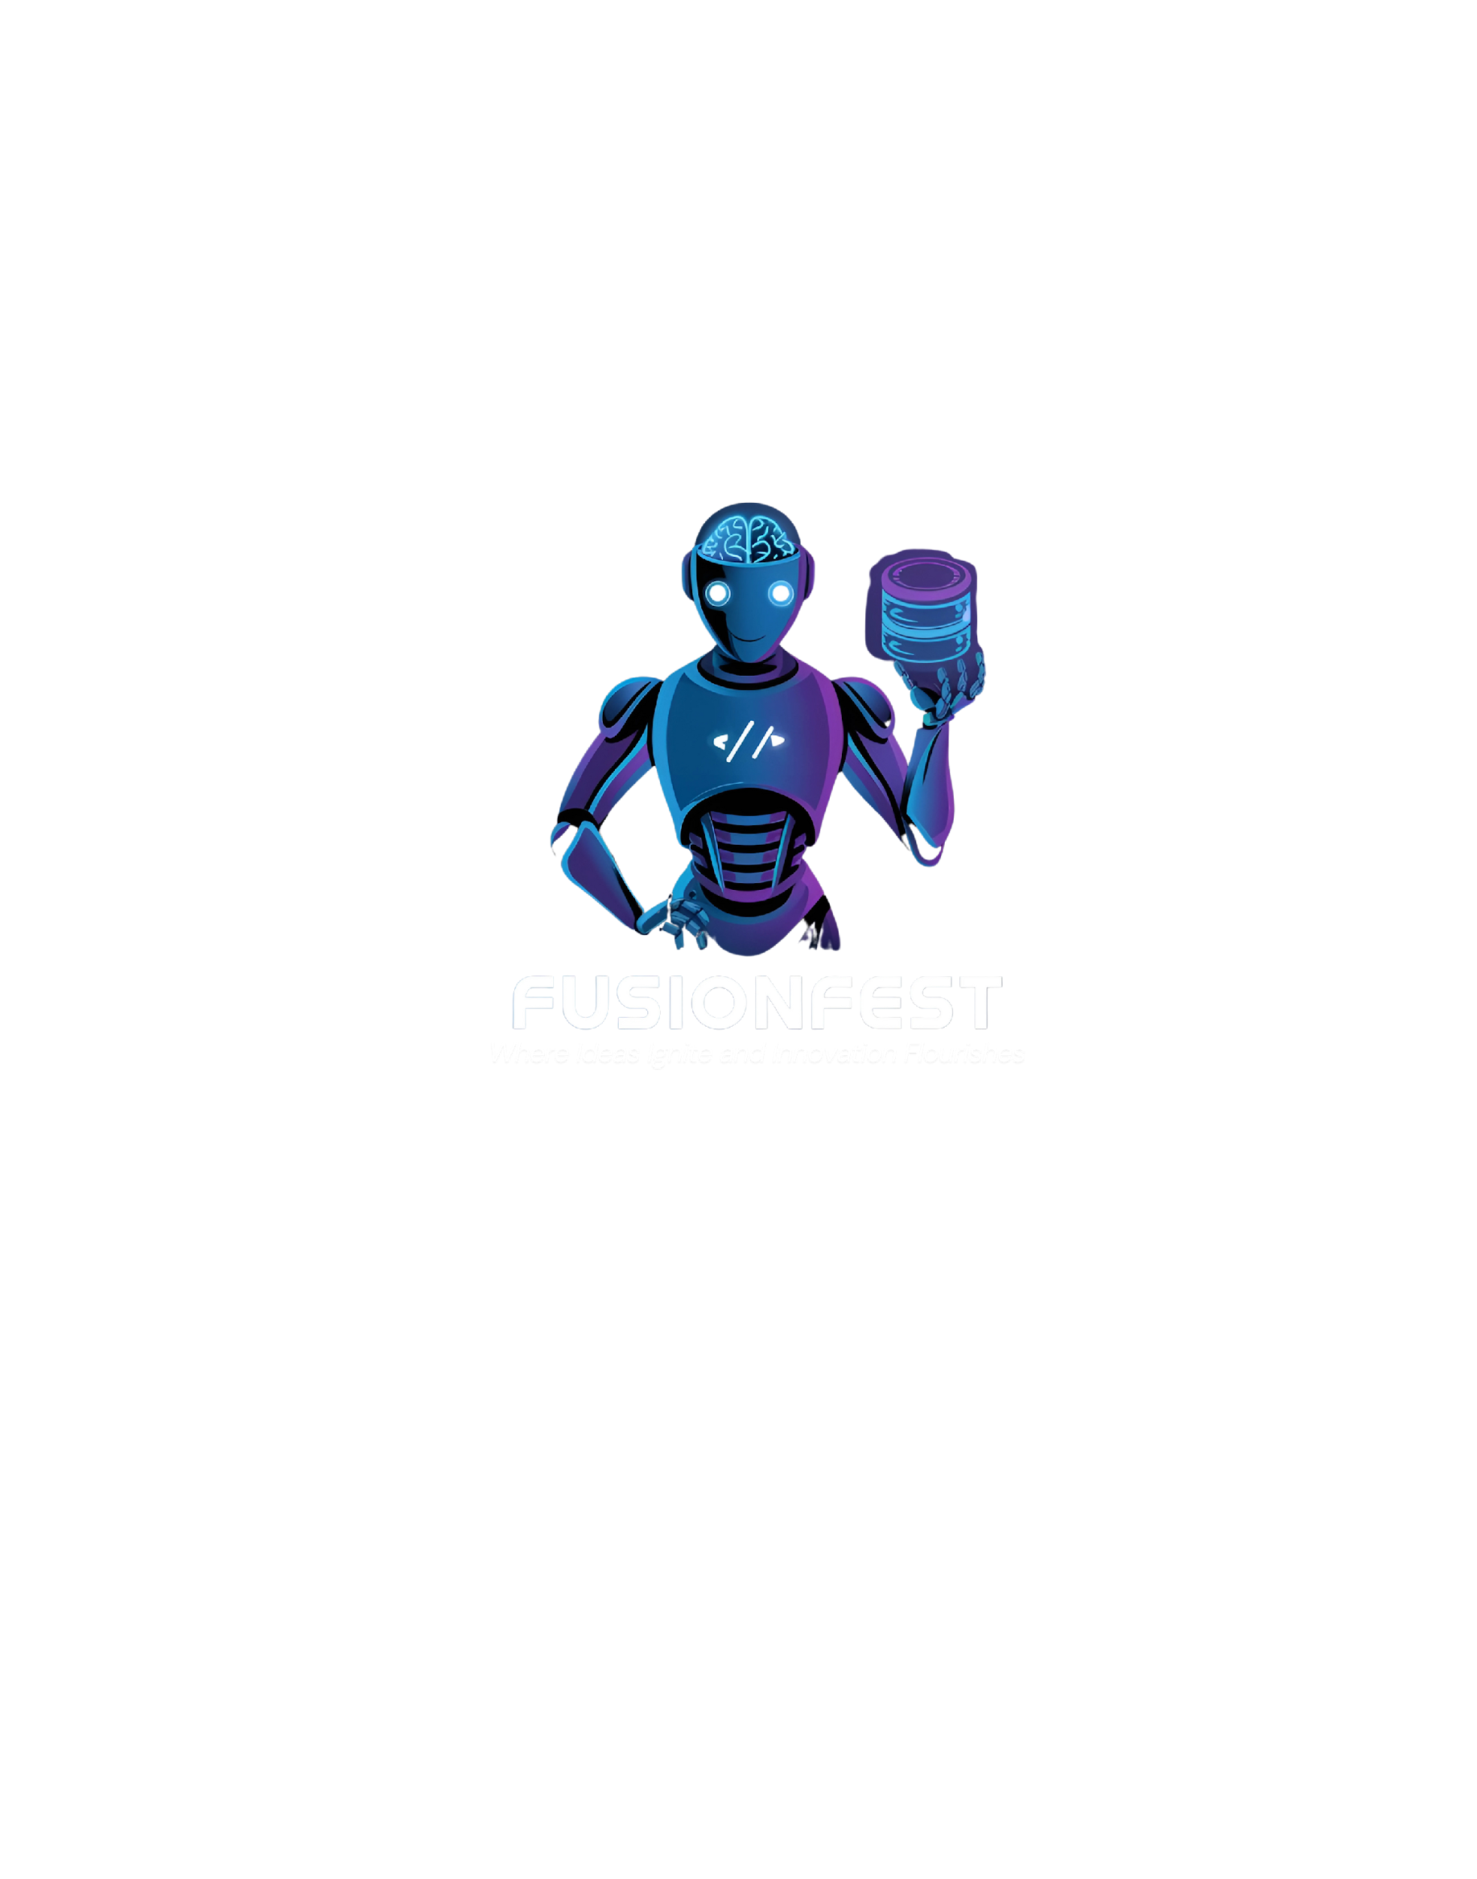
FUSION FEST HACKATHON 2025
Team: Code Phoenix
SkillSpark: Skill Exchange and Collaboration
FUSION FEST
HACKATHON

Slide 2
Fusion Fest Hackathon
Code Phoenix
FUSION FEST
HACKATHON
Problem Statement:
Many students face overwhelming challenges in completing their projects due to limited access to skilled collaborators, lack of funds, and insufficient resources. Our platform, SkillSpark, bridges this gap by creating a skill-exchange ecosystem where students can trade their expertise, collaborate on projects, and even secure micro-funding for innovation. With integrated features like booking management, verified collaborators, and in-house resources, we empower students to overcome these barriers and turn their ideas into reality. We will also provide the feature to book sessions with mentors those have good project management skills and knowledge about particular tech stack. We have our own resource hub to help students from our end also.

Slide 3
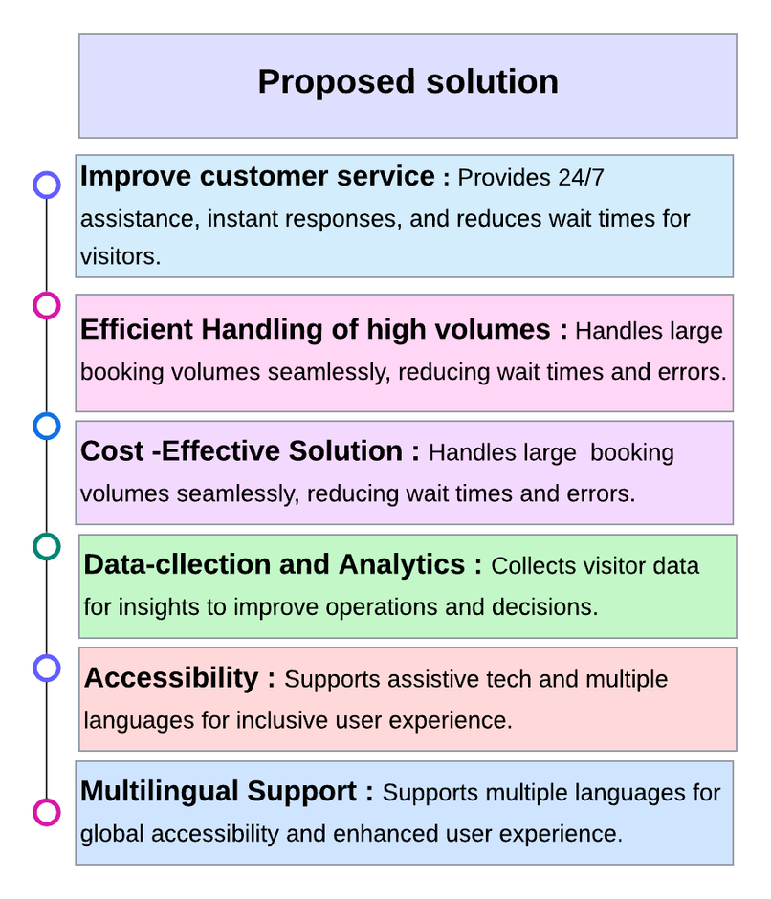
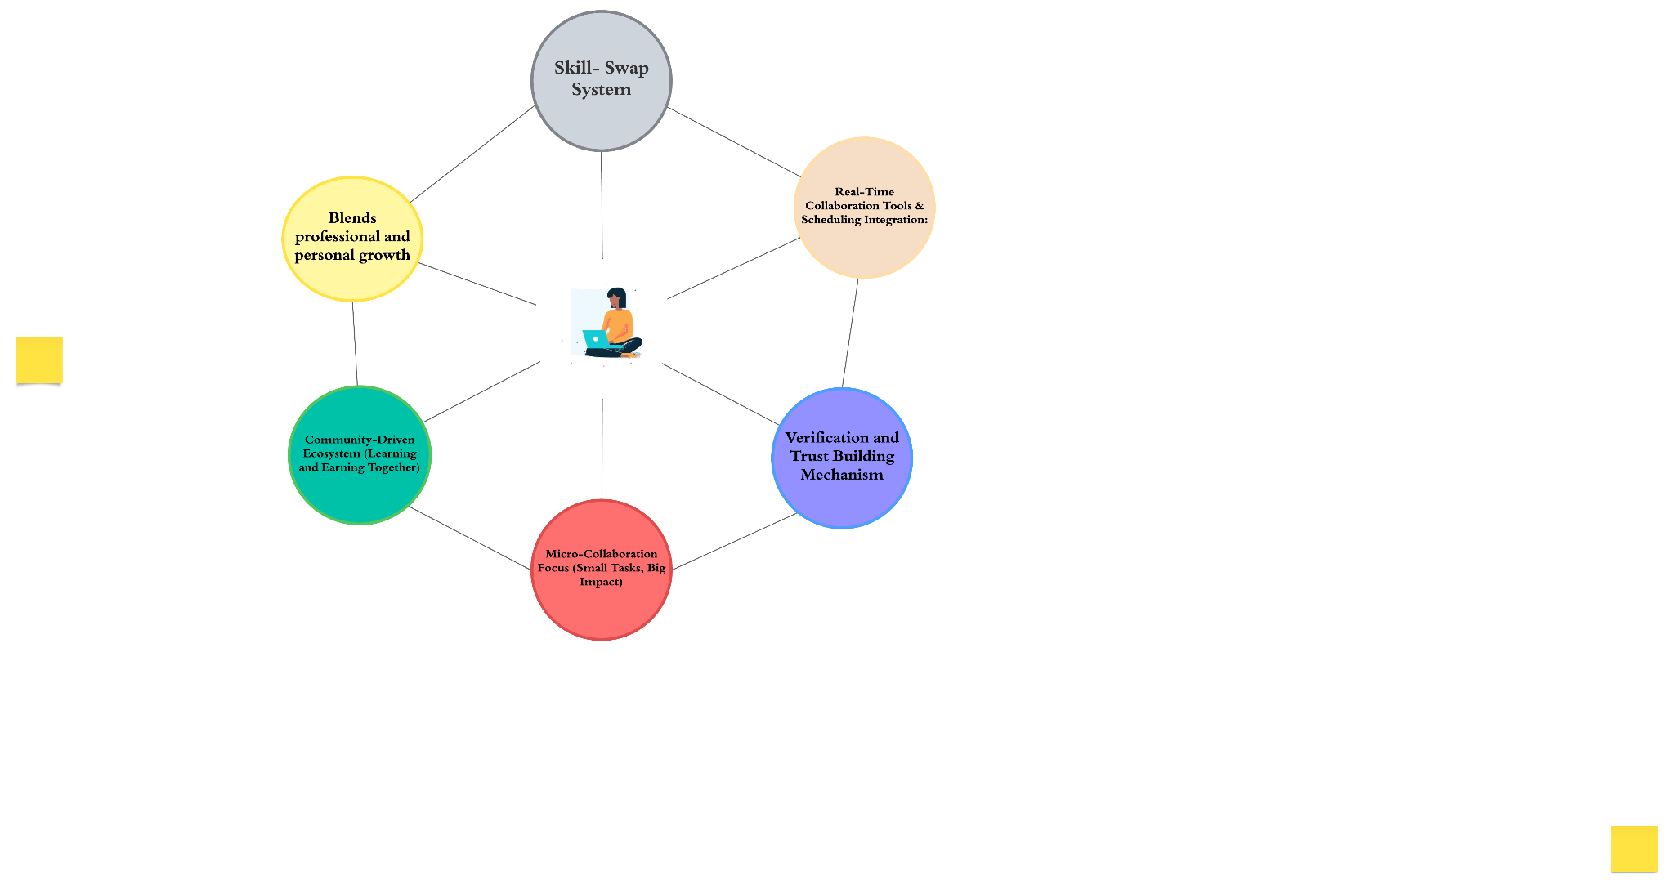
Fusion Fest Hackathon
Code Phoenix
Proposed Solution:
INNOVATION AND UNIQUENESS OF THE SOLUTION:
FUSION FEST
HACKATHON
User-Friendly Interface
Provide a seamless and intuitive platform to list, request, and manage micro-collaboration opportunities.
Standardized Skill Matching
Use filters to match users based on skills, availability, and preferences.
Transparent and Flexible Communication
Users can directly interact with each other for any doubt.
Automated Updates and Feedback
Regularly update platform features, while collecting continuous user feedback .
Real-Time Collaboration Tools
Enable instant bookings, scheduling, and collaboration with minimal delays.
Modular and Scalable Design
Create a customizable architecture, allowing easy integration of new features and support for legacy systems.
@SIH Idea submission- Template

Slide 4
Fusion Fest Hackathon
Code Phoenix
Key Features
FUSION FEST
HACKATHON
Skill Exchange Ecosystem: A unique platform where students can trade their skills with or without monetary exchange, fostering a collaborative community and also it helps in keeping the motivation alive between collaborators.
Verified Collaborators: Users are verified through their Github account.
Best Booking algorithm: Displays students based on complementary skills and project needs, ensuring efficient collaborations.
Built-In Micro-Funding Mechanism: Enables students to raise small-scale funding directly from collaborators or sponsors to support their projects.
No Platform Like This Exists: A truly innovative solution that combines skill exchange, collaboration tools, and micro-funding under one roof.
@SIH Idea submission- Template
4

Slide 5
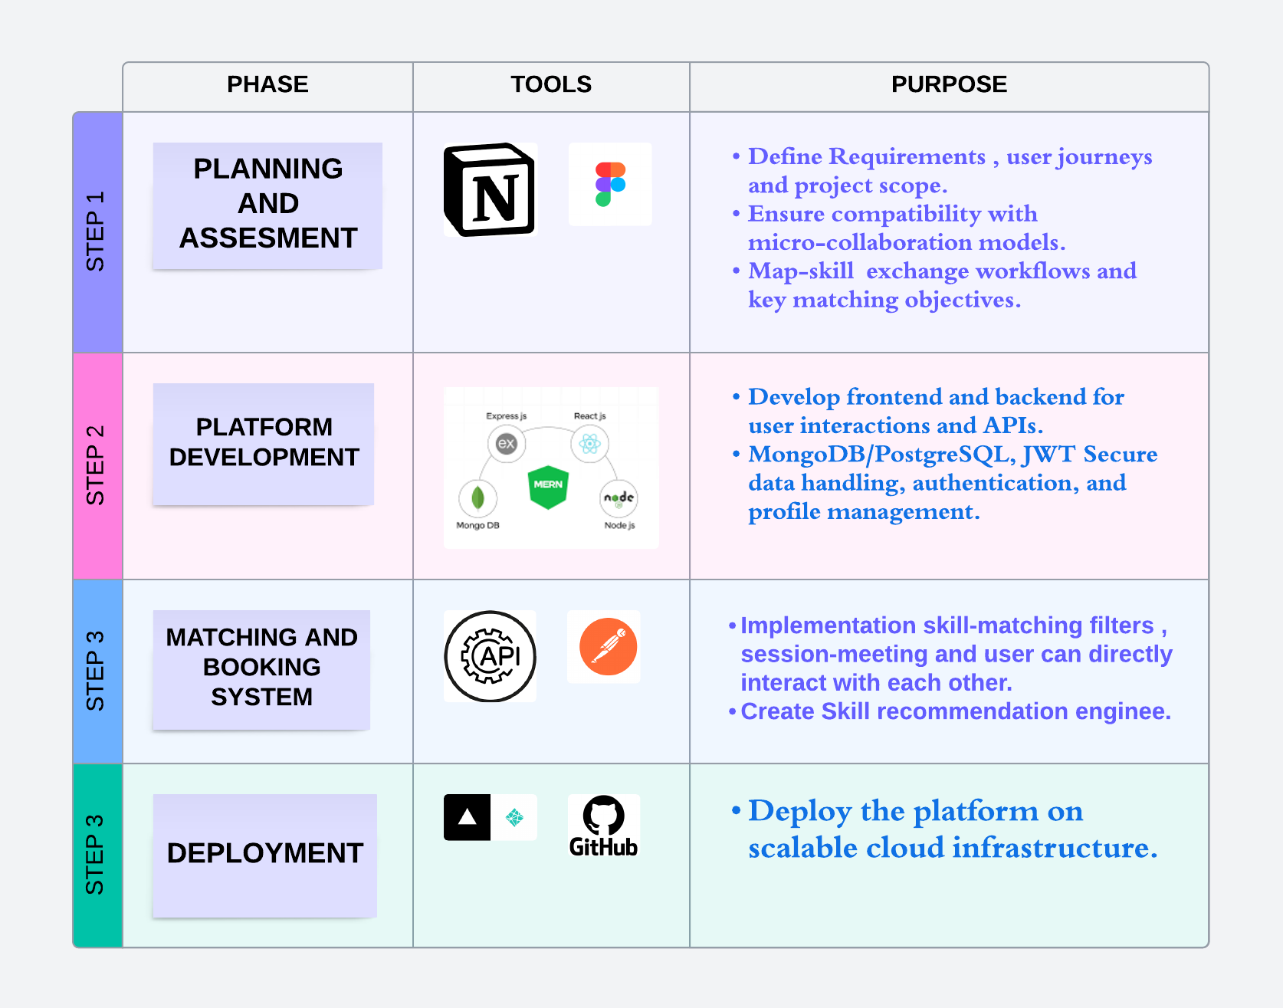
TECHNICAL APPROACH
Code Phoenix
FUSION FEST
HACKATHON
@SIH Idea submission- Template

Slide 6
FEASIBILITY AND VIABILITY
Code Phoenix
Feasibility:
Technical Feasibility: With a scalable MERN stack backend, modular architecture, and user-centric design, the platform is built to handle real-time collaborations effectively. Its robust backend ensures a smooth and bug-free experience for users.
Implementation Feasibility: The platform's core features, like skill exchange, secure payments, and session management, are already functional. Additional enhancements, such as gamification and advanced analytics, can be seamlessly integrated as part of future updates.
Viability:
Market Viability: The platform addresses an untapped market of students, researchers, and innovators, providing a unique solution to collaboration and funding challenges.
Business Viability: Monetization opportunities include commission-based micro-funding transactions, premium collaboration tools, and sponsorships from educational institutions or brands targeting students.
FUSION FEST
HACKATHON
@SIH Idea submission- Template

Slide 7
IMPACT AND BENEFITS
Code Phoenix
FUSION FEST
HACKATHON
Encourages cross-disciplinary learning and collaboration.
Makes project-based learning accessible for all students.
Reduces barriers to funding and resource sharing for innovative ideas.
Builds a community of skilled collaborators, fostering long-term networking.
Increases the success rate of student-led projects and startups.
Promotes a sustainable, skill-driven ecosystem for students worldwide.
Empowers students with a platform that values their skills and creativity.
@SIH Idea submission- Template

Slide 8
RESEARCH AND REFERENCES
Code Phoenix
FUSION FEST
HACKATHON
Project Ideation: ChatGPT, Gemini.
Project Structuring and Designing: Figma, Canva.
Collaborating with: Notion, GitHub
Frontend Implementation: https://react.dev/, https://v3.vitejs.dev/guide/, https://tailwindcss.com/
Backend Implementation: https://expressjs.com/, https://nodejs.org/, https://learning.postman.com/docs/introduction/resources/
Database Connection: https://www.mongodb.com/, MongoDB Atlas
Skill Exchange Ecosystem Inspiration: Research on community-driven platforms like Skillshare, Fiverr, UpWork, etc.
Micro-Collaboration Concept: Analysis of project management tools like Trello and Slack.
Micro-Funding Model: Crowdfunding platforms such as GoFundMe, Patreon, BuyMeACoffee, etc.
@SIH Idea submission- Template

